Slide 1
Time delay In Wide Area.
Presented By : Hazem Khaled.

Slide 2
Causes of Time delay in wide area from our perspective :
Sensors.
ADC.
Algorithm.
Communication.
  IEC 61850-90-5.
  Frame according to IEC 61850-90-5.
  Frame used in our project.
  Wireless-Kit vs parallel transmission.

Slide 3
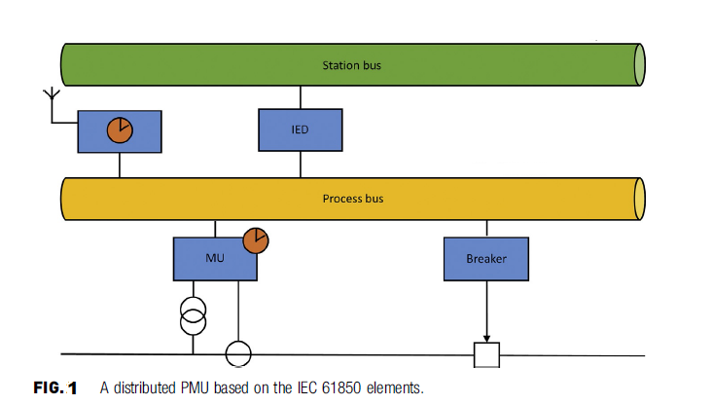
Distributed PMU.

Slide 4
Sensors:
Classification INSTRUMENT TRANSFORMERS (ITs) in two classification :
  “conventional” ITs, which include all the ITs proper—that is, inductive CTs, inductive VTs,and capacitive VTs.
  low-power instrument transformers (LPITs).
    which are “intended to , transmit a low-power analog or digital information signal to measuring instruments, meters and protective or control devices or similar apparatus.” LPITs, LPITs, whose output is a voltage, are further divided into
      active LPITs and passive LPITs.
      Example : Linear Coupler,Voltage dividers, Hall-effect-based current transducers belong all to this group.

Slide 5
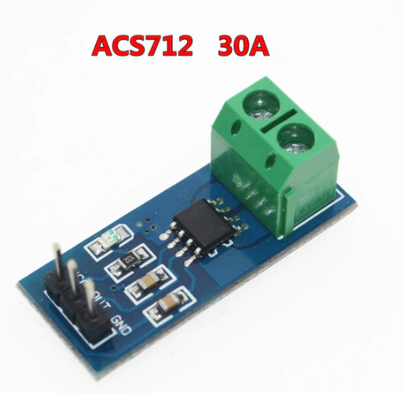
Current Sensor Used in our project:

Slide 6
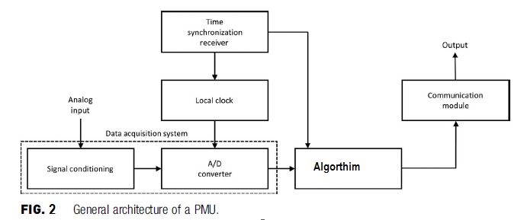
PMU Architecture :

Slide 7
Signal Conditioning ?
Signal Conditioning : Signal conditioning is the manipulation of a signal in a way that prepares it for the next stage of processing.
We use ACS712 Current Sensor which it’s output from :
  0 – 2.5 Volt in DC.
  2.5 – 5 volt in AC.
So In our project we reduce time by using current sensor which output is voltage, and suitable for ADC Processing.

Slide 8
Time Conversion in ADC?
Conversion Time : Time it takes the ADC To Convert the analog input to digital, This time depend on the algorithm used in ADC.
The conversion time is maintained constant in successive approximation type ADC, and is proportional to the number of bits in the digital output.
According to IEC-61850 Merging unit element it’s used successive approximation (SAR) method which have the following characteristic :
  Constant time.
  High Efficiency.
(SAR) Based on comparison.
In our project we used the same algorithm used in the standard.
As we Explain the topic from point of view of a Time let’s explain it.

Slide 9
Conversion time in (SAR) depend on :
  Number of bits (Resolution).
Rules of Conversion :
  The MSB is initially set to 1 with the remaining three bits set as 000. The digital equivalent voltage is compared with the unknown analog input voltage.
  If the analog input voltage is higher than the digital equivalent voltage, the MSB is retained as 1 and the second MSB is set to 1.
  Otherwise, the MSB is set to 0 and the second MSB is set to 1. Comparison is made as given in step (1) to decide whether to retain or reset the second MSB.

Slide 10
Example :
  If we have analog input equal to 4 V and we want to convert it to digital value,
  And we have ADC 4-bit resolution so the following will happen :
1000 which is (8 in decimal) > 0100 (4 in decimal) .. So right shift one step.
100 which is (4 in decimal) == 0100 (4 in decimal) .. We find the solution .. Add one 0110(6 in decimal).
0110 ( 6 in decimal ) > 0100 ( 4 in decimal ) .. So right shift one step.
0101 ( 5 in decimal ) > 0100 ( 4 in decimal ) .. So drop one.
The solution is 100 as input .. We notice that after ( SAR ) found the solution ans it continue so it’s time constant .. depend on resolution (4-bit resolution in our case).

Slide 11
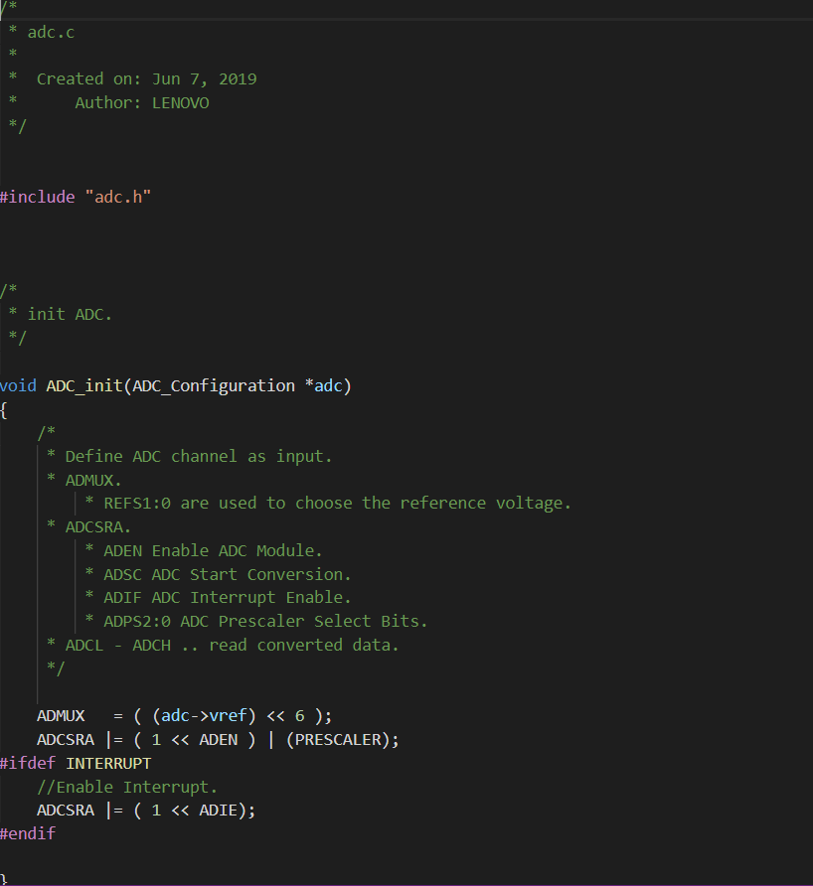
Our ADC Library For Atmega128 :

Slide 12
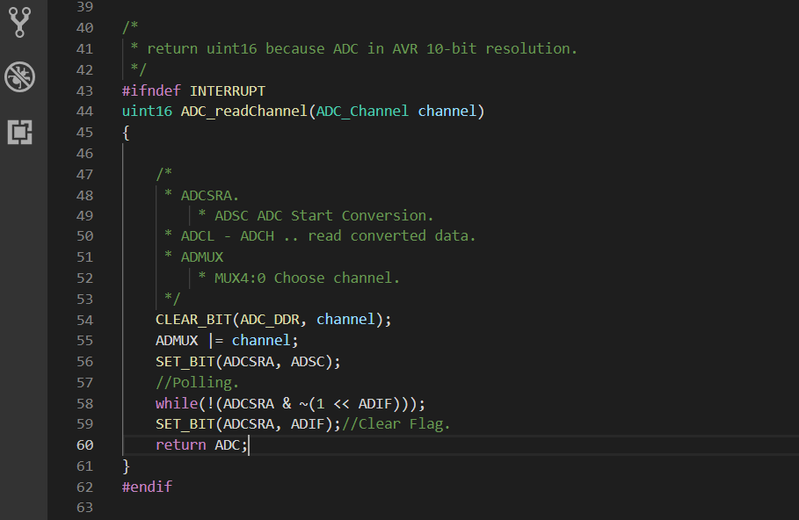

Slide 13
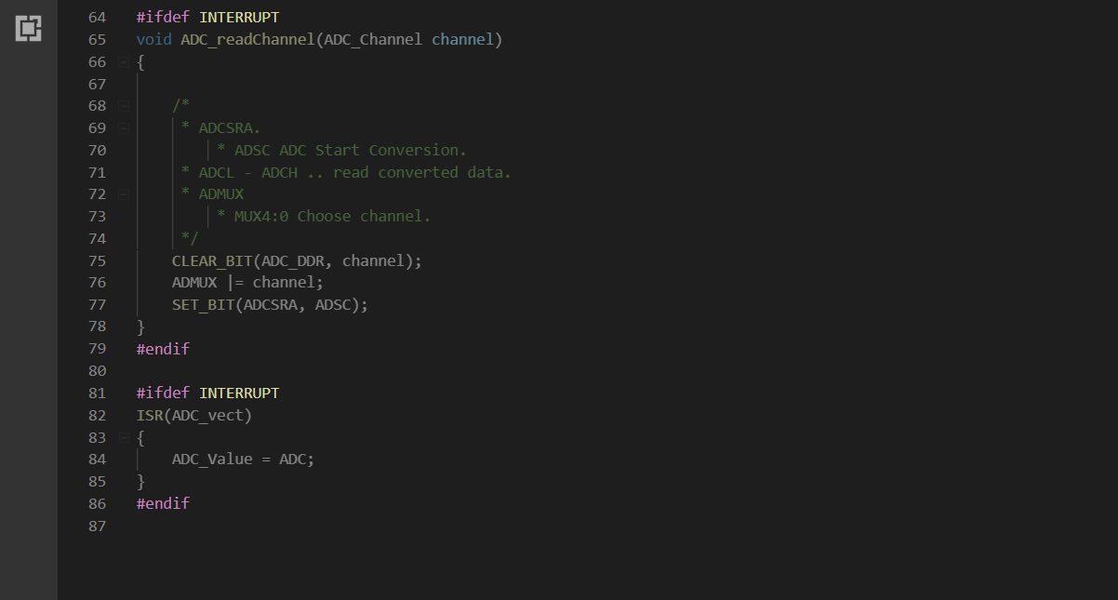

Slide 14
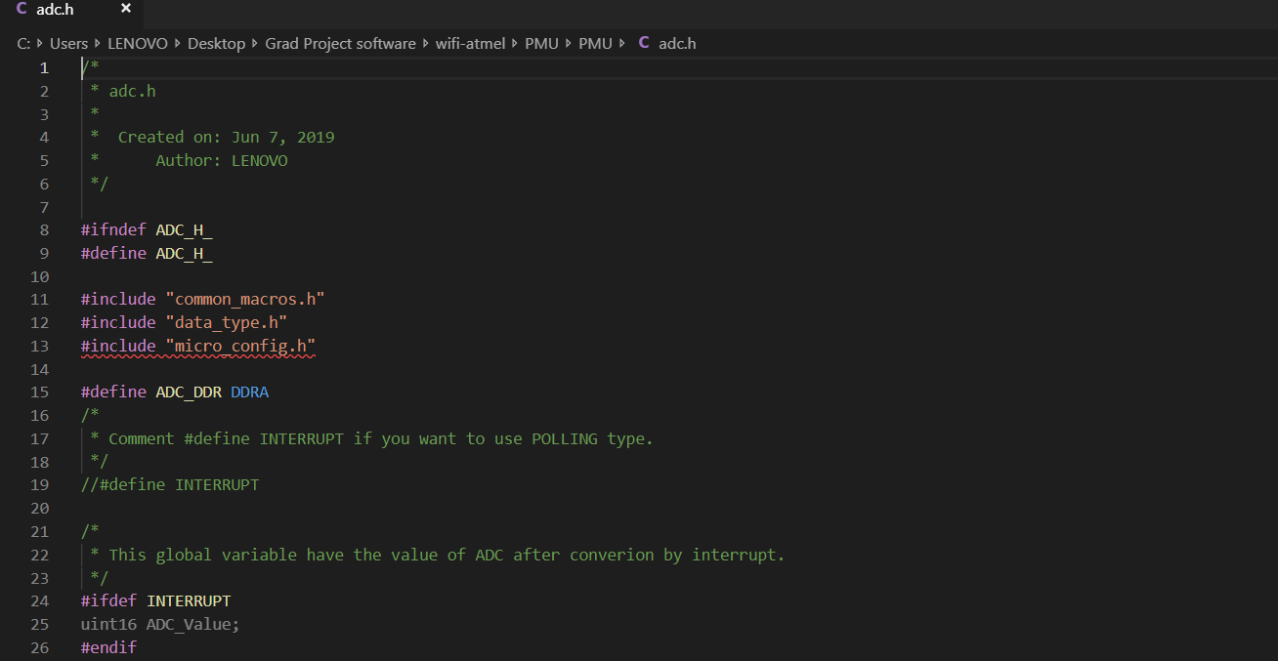

Slide 15
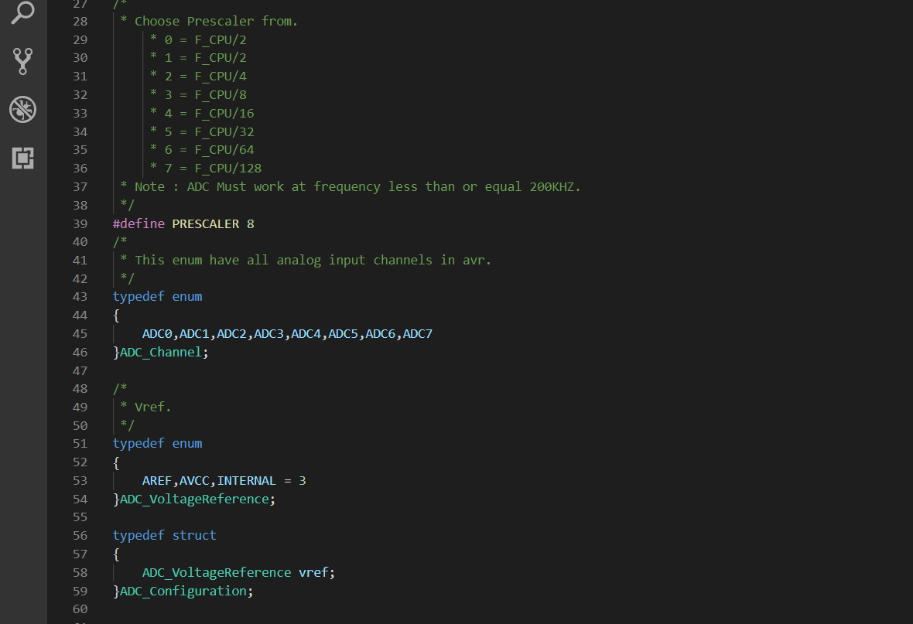

Slide 16
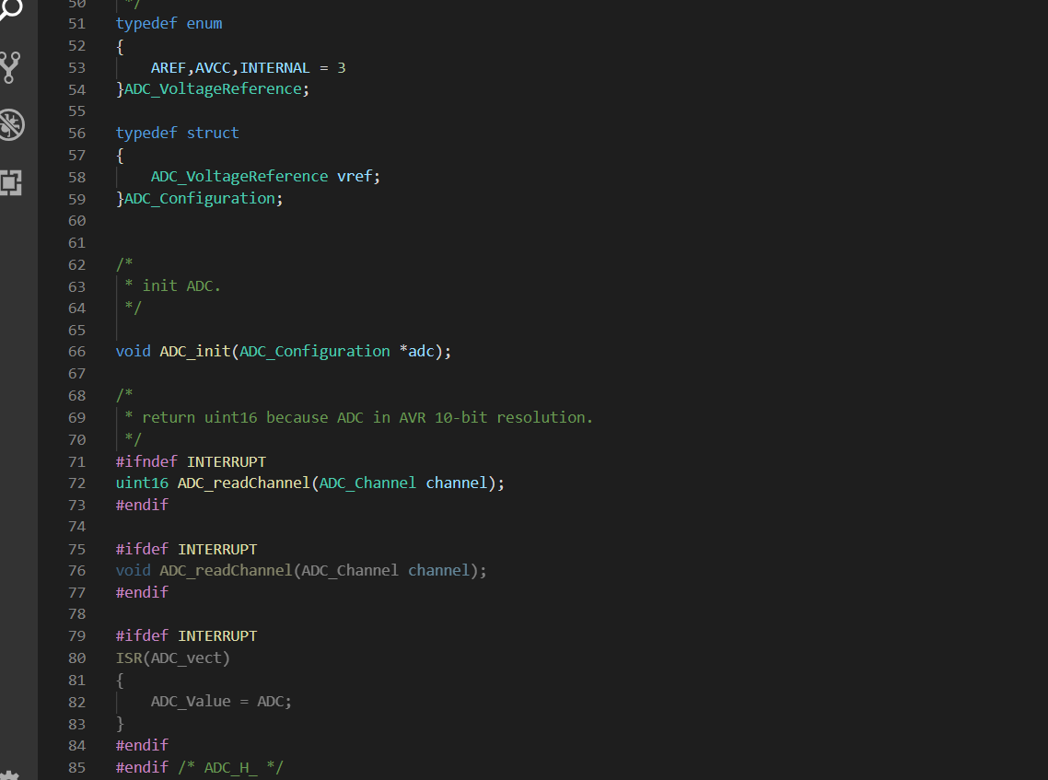

Slide 17
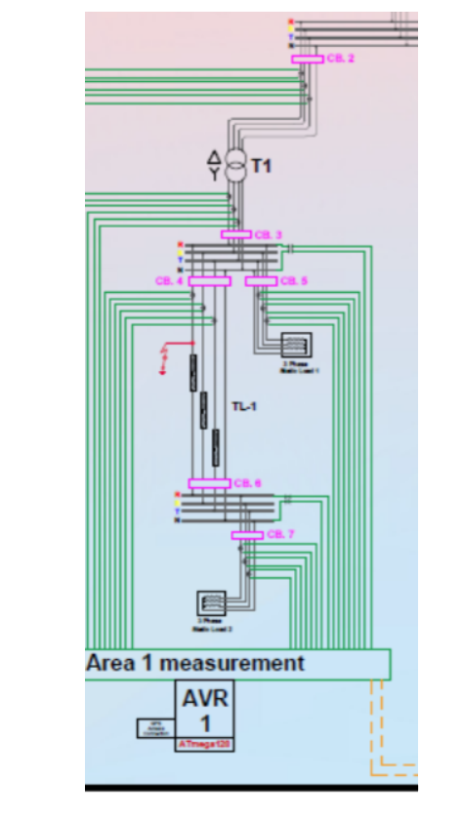
Our Algorithm Used To Synchronized Data.

Slide 18
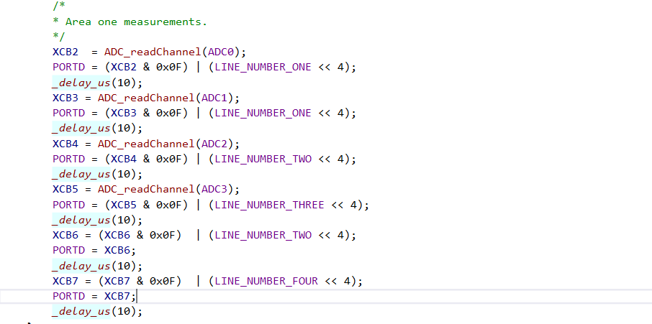

Slide 19
Delay in Communication.
Type of communication :
  Series OR Parallel.
Frame Size:
  In our project :
    Parallel : No overhead In data .. it’s about (2 ms in our project).
    Series:
      Overhead In Data .. It’s about (10 ms in our project).
      We Used UART Protocol.

Slide 20
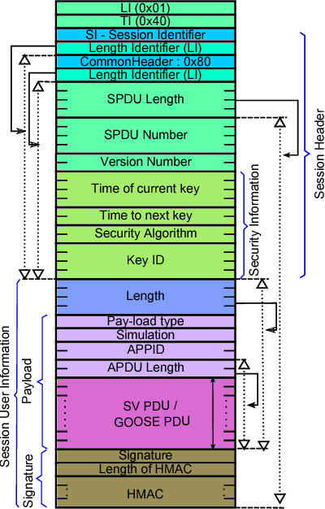
Frame In IEC 61850-90-5.

Slide 21
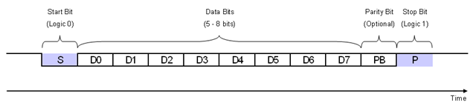
Frame In our project :
Serial Communication Frame :

Slide 22
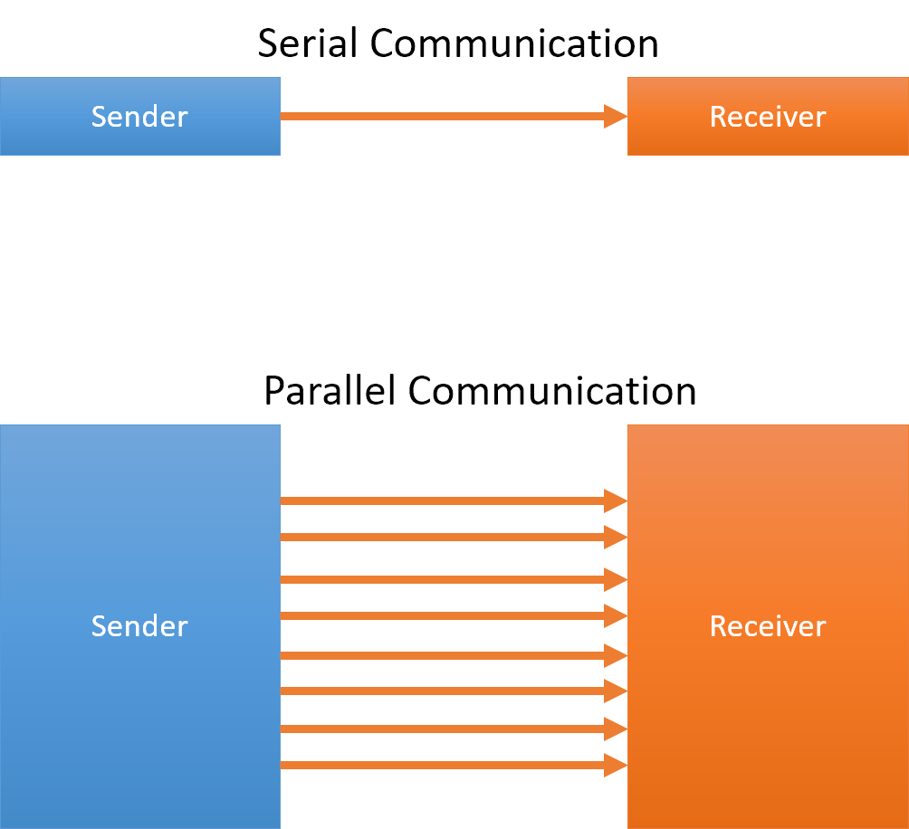
Parallel Communication Frame :

Slide 23
Thank You
Any Questions ?

